Slide 1
Pythagoras’ Theorem Working out a Shorter Side
Notes:
Possible resources
http://www.scootle.edu.au/ec/viewing/L6559/index.html

Slide 2
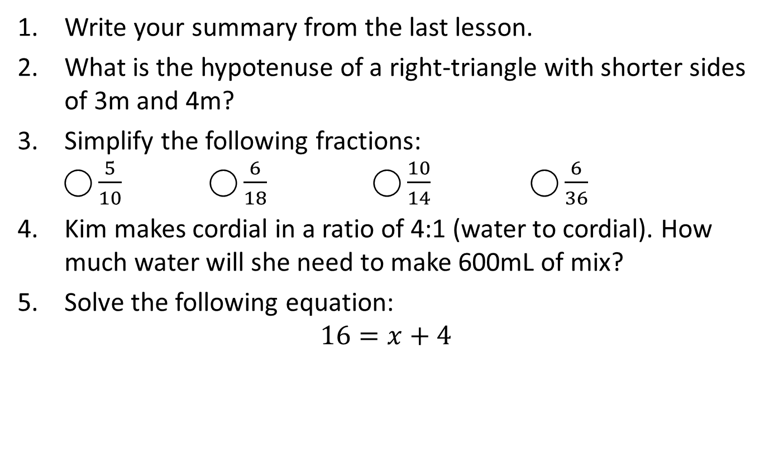
Warm Up (LHS)
Write your summary from the last lesson.
What is the hypotenuse of a right-triangle with shorter sides of 3m and 4m?
Simplify the following fractions: ⃝ $\frac{5}{10}$ ⃝ $\frac{6}{18}$ ⃝ $\frac{10}{14}$ ⃝ $\frac{6}{36}$
Kim makes cordial in a ratio of 4:1 (water to cordial). How much water will she need to make 600mL of mix?
Solve the following equation: $16=x+4$

Slide 3
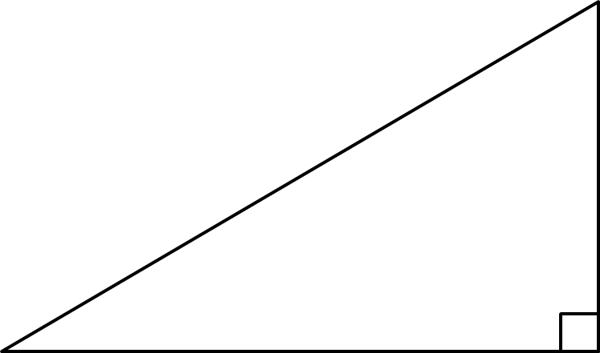
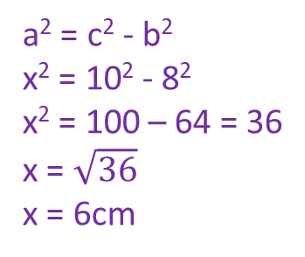
24
7
30
Topic: Right-Angled Triangles
Date
EQ – How can we work out shorter side of right-angled triangles?
What is Pythagoras’ Theorem?
a² + b² = c²
c
a
b
How do we use it to find a shorter side?
To work out a shorter side, rewrite the formula as:
a² = c² - b²
Example:
10cm
x
8cm
a² = c² - b²
x² = 10² - 8²
x² = 100 – 64 = 36
x = $\sqrt{36}$
x = 6cm
Step 1: Write the equation
Step 2: Rewrite it using the values we know
Step 3: Solve for the unknown

Slide 4


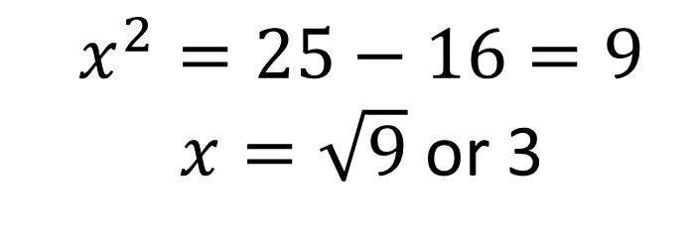
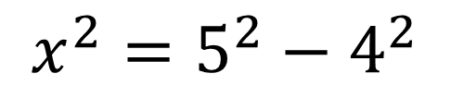

Let’s Try this Together
Step 1: To work out the shorter side.
Reveal >
$$5$$
$$x$$
Step 2: Form an equation
?
$$x^{2}=5^{2}−4^{2}$$
The shorter side appears on its own.
$$4$$
Step 3: Solve the equation to find the unknown side.
$$x^{2}=25−16=9$$ $x=\sqrt{9}$ or 3
?

Slide 5


Slide 6
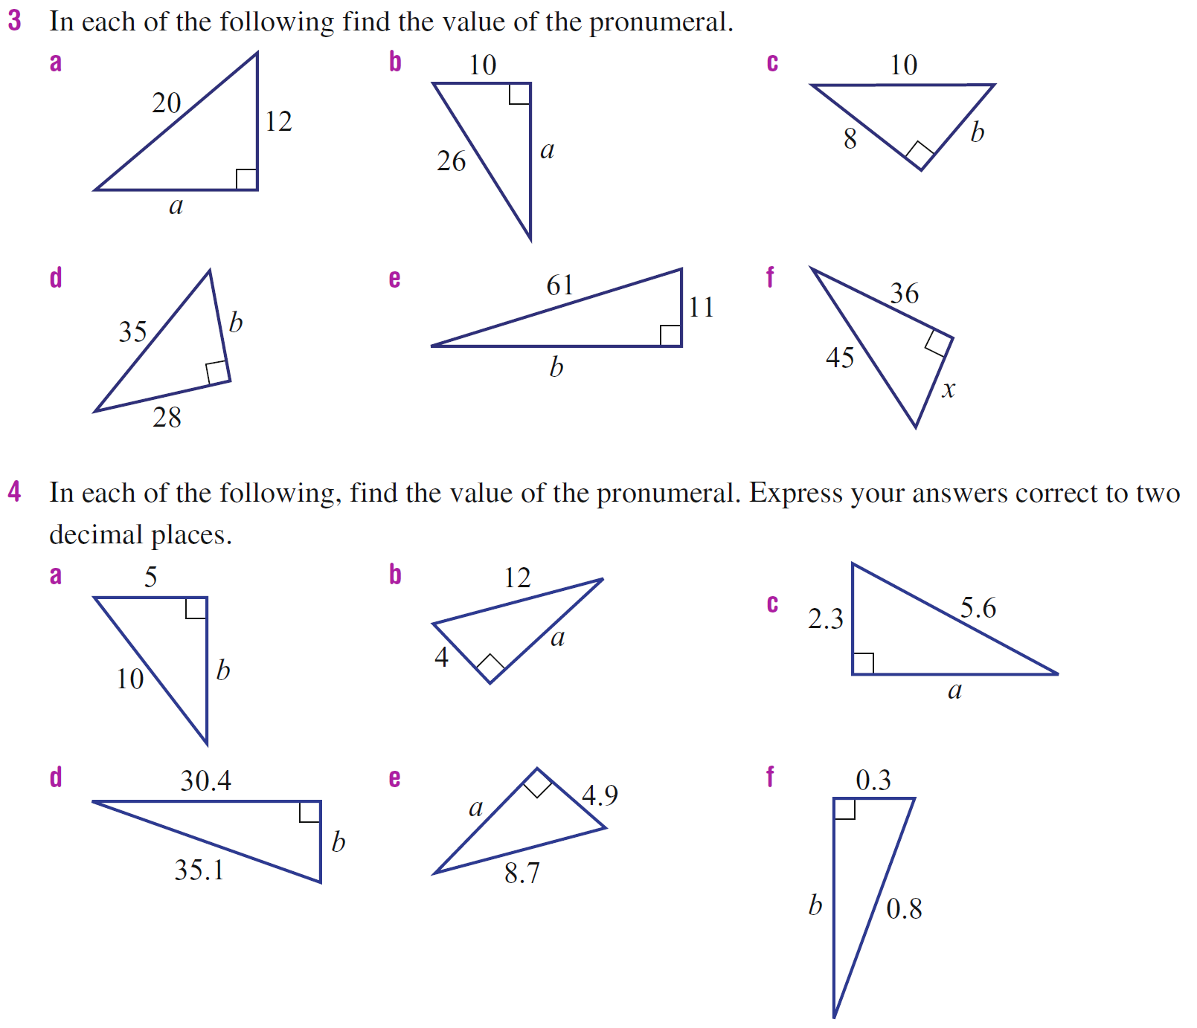
Practice

Slide 7
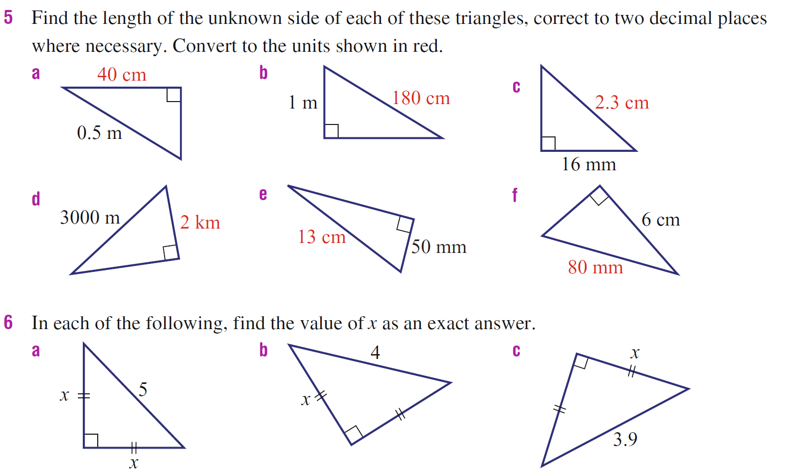
Extend

Slide 8
24
7
30
Topic: Right-Angled Triangles
Date
EQ – How can we work out a shorter side of right-angled triangles?
Summary
To work out a shorter side of a right-angled triangle when we know the hypotenuse and the other side we rewrite Pythagoras’ Theorem to get the unknown side by itself. It looks like ________ = ________ - __________.
Our last step is to take the ___________________ of the answer.

